Slide 1

Amin Aghakasiri
September 2024

Slide 2

Outline
Executive Summary
Introduction
Methodology
Results
Conclusion

Slide 3
Executive Summary
This project utilizes SpaceX's Data API and Falcon 9's Wikipedia page to collect data on successful and failed first stage launches and the variables that played a part in that outcome. Using tools such as SQL, Data Visualization and Machine Learning the following was learned
• The variable with the highest impact on successful landing was Payload Mass, with most successful landing happening with a payload mass between 2000 to 6000 kg. The most successful landing site was KSC LC-39A with a 76.9% success rate. Lastly our machine learning algorithms outputted an R2 score of 0.83 and F1 score of about 0.89 displaying their successful ability to predict future landing outcomes.

Slide 4
Introduction
SpaceX has a strong grip on space exploration and travel due to its sharp decrease in costs compared to its competitors. This decrease is a result of their ability to reuse the First Stage.
This project assumes a new client wishes to replicate SpaceX's success. In order to do so it predicts the success rate of the first stage landing in an attempt to help determine the cost of a launch.

Slide 5

Section 1

Slide 6
Methodology
Executive Summary
Data collection methodology:
Data was collected through Falcon 9's Wikipedia page and SpaceX's data API
Perform data wrangling
Data was processed to create a new variable based on landing outcomes that depicted a 1 in the case the landing outcome was successful and 0 when it failed
Perform exploratory data analysis (EDA) using visualization and SQL
Perform interactive visual analytics using Folium and Plotly Dash
Perform predictive analysis using classification models
• The following models were used: Logistic Regression, SVM, Decision Tree and KNN. Each Model had gone through a hyperparameter optimization process to select its most efficient parameters

Slide 7

Data Collection-SpaceX API
Remove unnecessary columns and use data ID's and premade functions to request launch data from API
Import libraries and use get request to connect and obtain raw data
from SpaceX API
Decode response content using .json()
load into pandas dataframe using
.json_normalize()
Restrict data in the dataframe to only hold information about Falcon 9
Load launch data into a dictionary and use that to create a dataframe
Import dataframe into csv file to use for later analysis
Replace null values in Payload Mass with mean
GitHub Link: Data Collection API

Slide 8

Data Collection - Scraping
Create a BeautifulSoup object from the html response and load all the data tables from the wiki page into a list
Import libraries and use get request to connect and obtain html response from Falcon 9 Wikipedia Page
Select the third table from the list and extract column names
Create an empty dictionary with the column names as the keys
Iterate through the table rows and load the data into the dictionary using the premade functions
Import dataframe into csv file to use for later analysis
Use the data filled dictionary to create a pandas dataframe
GitHub Link: Data Collection Web Scraping

Slide 9

Data Wrangling
Data Formatting
Look for null values, and incorrect data types within each column of the data set
In order for further analysis to result in accurate insights, data must be formatted in a way that does not skew or misinterpret information.
Using .value_counts() calculate the number and occurrence of each Launch Site, Orbit, and Landing Outcome
In this scenario the column "landing class" was formatted into a binary class that would later allow Machine Learning Algorithms to understand it.
Create a new column called landing class within the data set that outputs a 1 if the landing outcome was successful and a 0 if it failed
Calculate the mean of this new column to find the success rate of all the missions
After ensuring the data is ready further analysis
save it so a csv file
GitHub Link: Data Wrangling

Slide 10



EDA with Data Visualization
1. Bar plots: Great at comparing categorical values with a numerical value.
2. Scatter plots: Excel at comparing two independent variables with each other and can show possible correlation
3. Line plots: Help show trends in data a period of time
Bar Plots:
- Orbit Type vs Success Rate
Scatter Plots:
- Payload Mass vs Orbit Type
Line Plots:
- Date vs Success Rate
GitHub Link: Data Visualization

Slide 11
EDA with SQL
SQL Queries:
Load data set into pandas data frame then used dataframe.to_sql() to create SQL
Table
Displayed Distinct Launch Sites
Displayed 5 Launch Sites whose name begin with CCA
Displayed Total Payload Mass carried by boosters launched by NASA(CRS)
Displayed Average Payload Mass carried by booster version F9 v1.1
Displayed the date in which the first successful ground pad landing occurred
Displayed the names of the boosters which successful land in drone ships and have a
payload mass greater than 4000 kg but less than 6000
Displayed the total number of Successful and Failure mission Outcomes
Using a Subquery displayed the names of all booster versions which have carried the
maximum payload mass
Displayed the month of failed landing outcomes in drone ships, booster versions, and
launch site in the year 2015
Displayed the different types of landing outcomes between 2010-06-04 and 2017-03- 20 and the number of times they occurred in descending order
GitHub Link: EDA with SQL

Slide 12




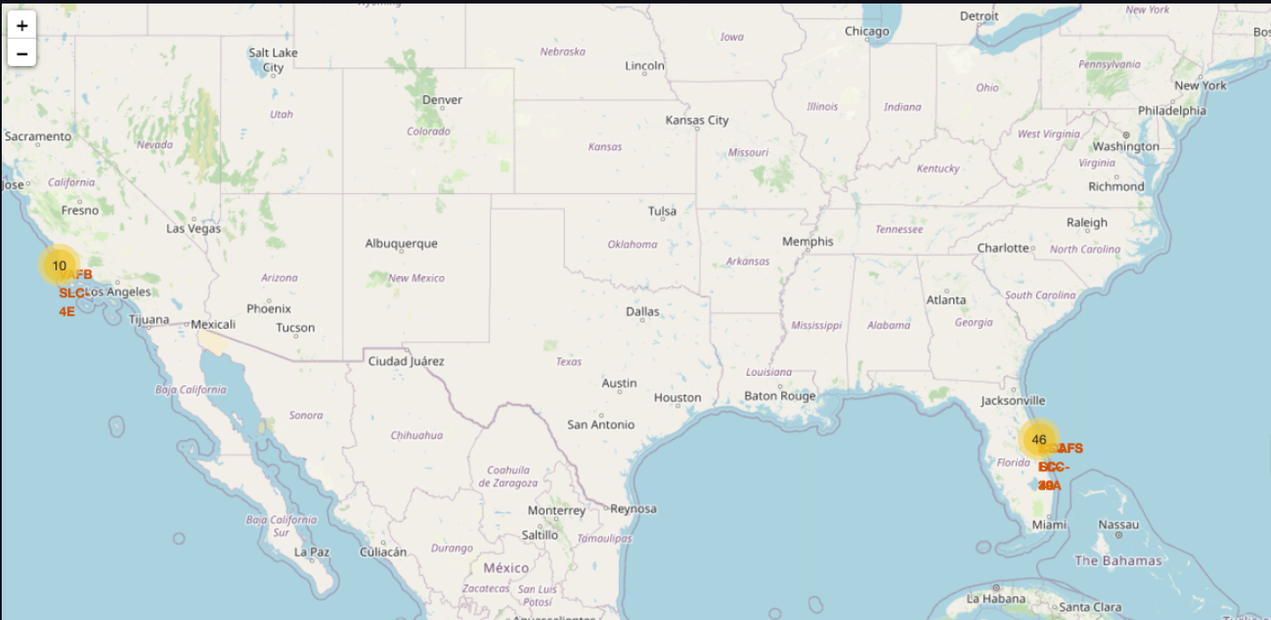
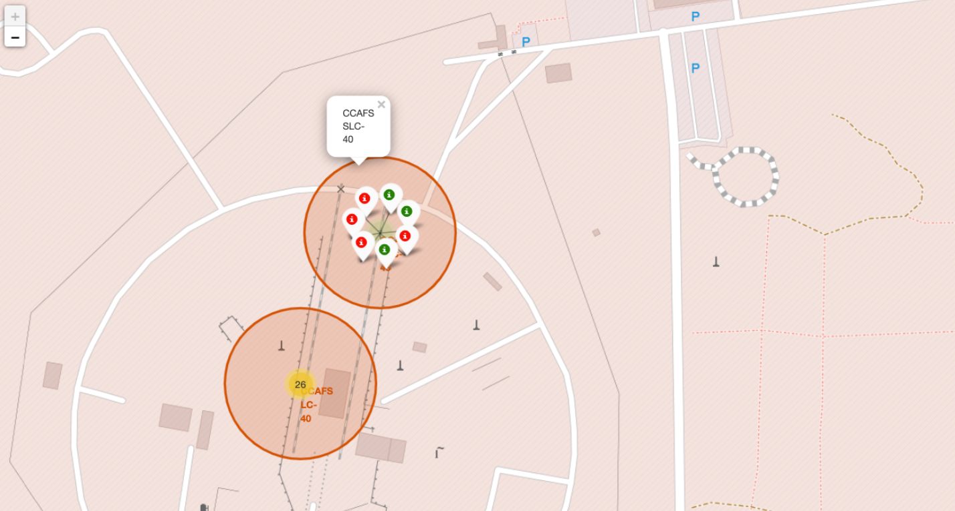
Build an Interactive Map with Folium
Main Map
- Centered at Nasa Johnson Space Center (JSC)
Circles
Red Circle positioned on NASA headquarters that shows displays a popup with its name when clicked
4 different colored circles positioned on each
rocket launch site that display their names as a
popup when clicked
Clusters
Marker clusters positioned on each rocked launch site that display the total number of landings
When zoomed in and clicked on a spiral of clusters
is displayed with a green marker for each successful landing and a red marker for each failed landing
Mouse Position
- An add-on that displays the current latitude and longitude of your cursor as it hovers over the map
GitHub Link: SpaceX Folium Map

Slide 13

Build a Dashboard with Plotly Dash
Dashboard Outline
Title: SpaceX Launch Records Dashboard
Title is bolded and centered Equipped with a Dropdown menu
Allows you to choose All Launch Site statistics or an individual Launch Site's statistics
Dashboard Visualizations
Pie Charts
The All Sites dropdown shows a pie chart that compares the number of successful landings between all the launch sites
Each individual site dropdown shows a pie chart that
compares is landing success rate
Scatter Plot and Range Slider
A scatter plot is shown that compares the Payload Mass (x-axis) and whether or not the launch successfully landed (y-axis)
The points are colored based on Booster Version
Category
The slider allows you to control the Payload Mass range
GitHub Link: Interactive Dashboard Analysis

Slide 14



Predictive Analysis (Classification)
Create a NumPy array that holds the target "Class" column's data and a dataframe X
that holds the independent attributes data
Standardize X data using .StandardScalar() then proceed to split data into 80% train
and 20% test using train_test_split()
Create Logistic Regression Model | Create Support Vector Machine Model | Create Decision Tree Classifier Model | Create K-Nearest-Neighbors Model
Create a dictionary for each model with multiple hyperparameters then create a GridSearchCV object to find the best possible parameters
Find R^2 Score for each Machine Learning model and create a Confusion Matrix Compare each models score and select the highest performing algorithm
GitHub Link: Machine Learning Prediction Algorithms

Slide 15

Section 2

Slide 16
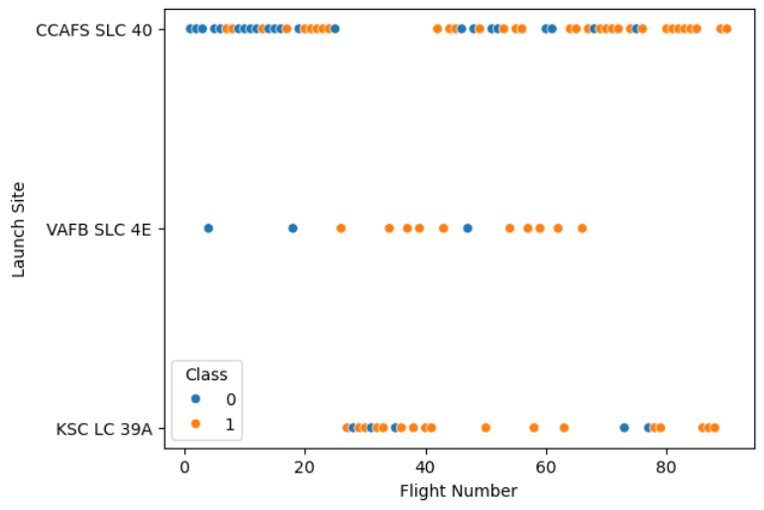
Flight Number vs. Launch Site
Insight:
CCAFS SLC 40 has the highest amount of launches
Success rate increases as flight number increases

Slide 17
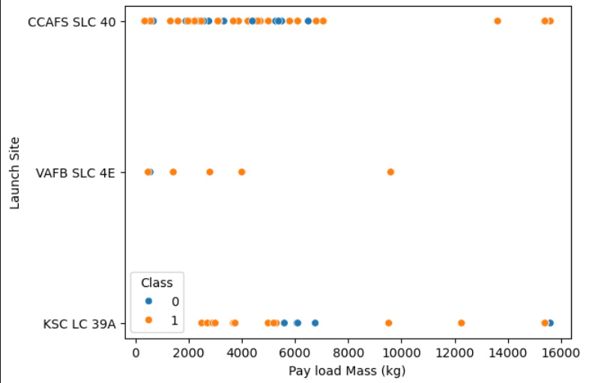
Payload vs. Launch Site
Insight:
VAFB SLC 4E has no launches for rockets with a payload mass greater than 10000
Majority of launches with a high payload mass had a higher success rate than those with low payload mass

Slide 18
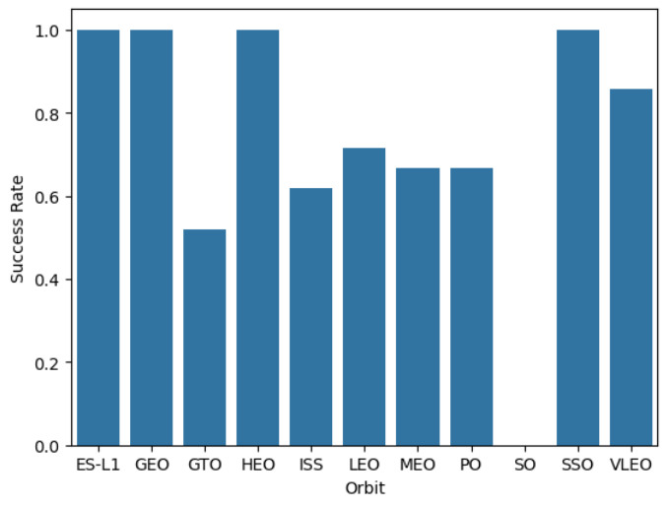
Success Rate vs. Orbit Type
Insights:
Orbits ES-L1, GEO, HEO, and SSO have a 100% success rate
Orbit VLEO has the second highest success rate
Orbit SO has a 0% success rate
Orbit GTO has the second lowest success rate

Slide 19
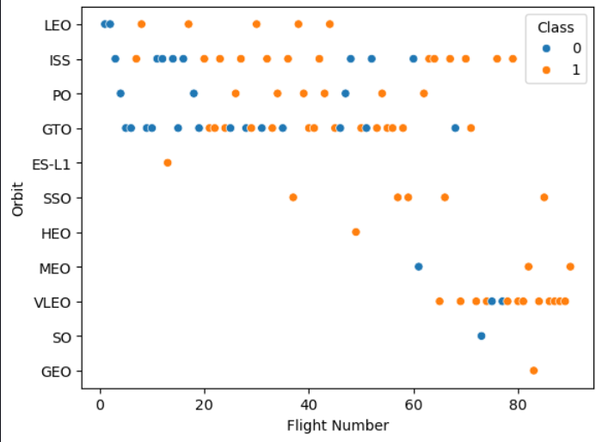
Flight Number vs. Orbit Type
Insights:
Orbit VLEO only has launches with a flight number above 60
Orbits ES-L1, GEO, and HEO only
have a single launch
All of which are successful
Orbit LEO has a 100% success
rate after its first two failures
Orbits ISS, GTO, and VLEO have the most launches
Orbit GTO's success rate has no relationship with flight number

Slide 20
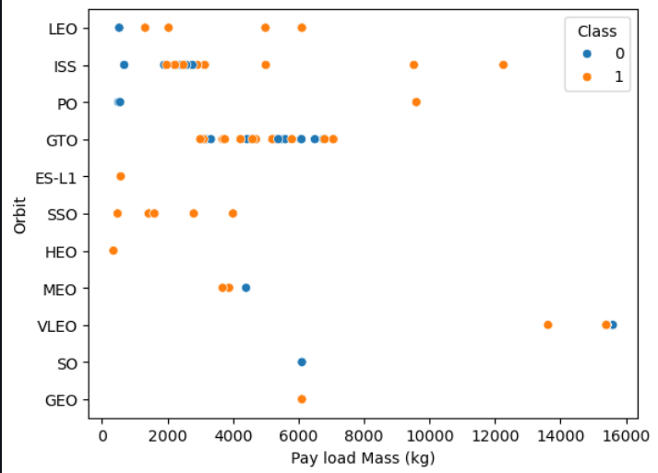
Payload vs. Orbit Type
Insight:
Orbit GTO only has launches with a payload mass between 2000 kg and 8000 kg
Orbit BLEO only has launches with payload mass above 13000 kg
Orbits PO, LEO, and ISS have a strong positive relationship with payload mass

Slide 21
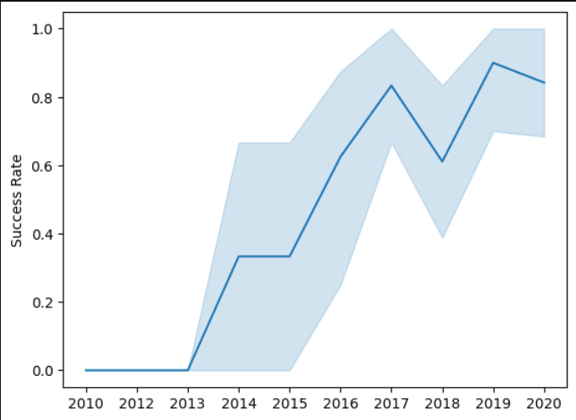
Launch Success Yearly Trend
Insights:
Success rate had periods of sharp increases between 2013-2014,
2015–2017, and 2018-2019
Success rate had periods of stagnation between 2010–2013
and 2014-2015
Success rate had periods of decline between 2017–2018, and 2019–2020
Overall success rate has increased drastically since 2013

Slide 22
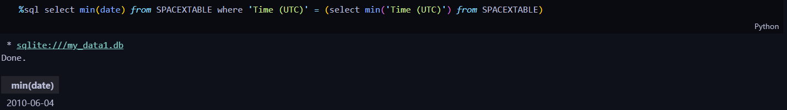
First Successful Ground Landing Date

Slide 23
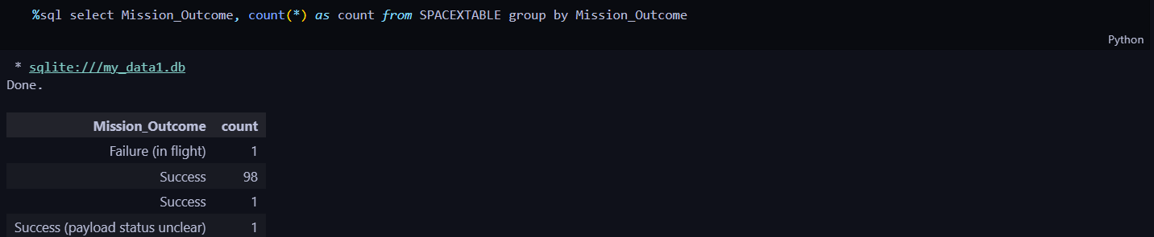
Total Number of Successful and Failure Mission Outcomes

Slide 24
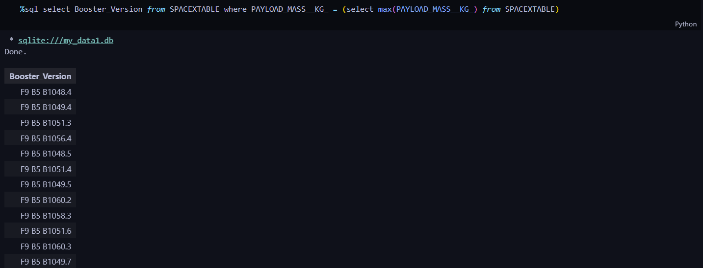
Boosters Carried Maximum Payload

Slide 25
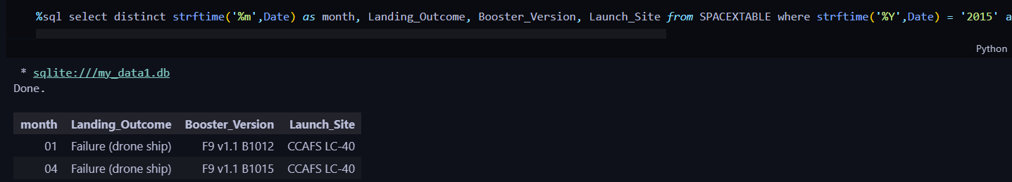
2015 Launch Records

Slide 26
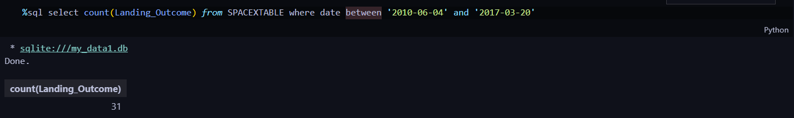
Rank Landing Outcomes Between 2010-06-04 and 2017-03-20

Slide 27

Section 3

Slide 28
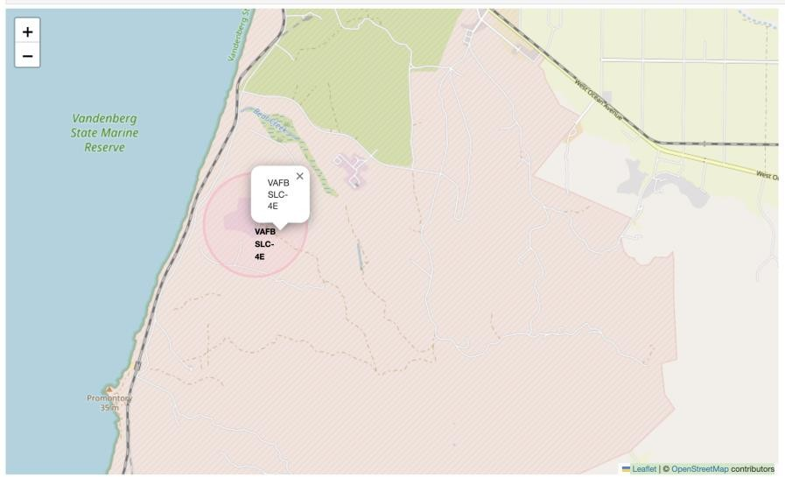
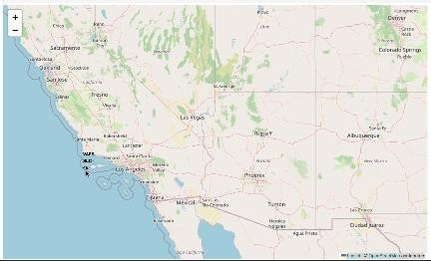
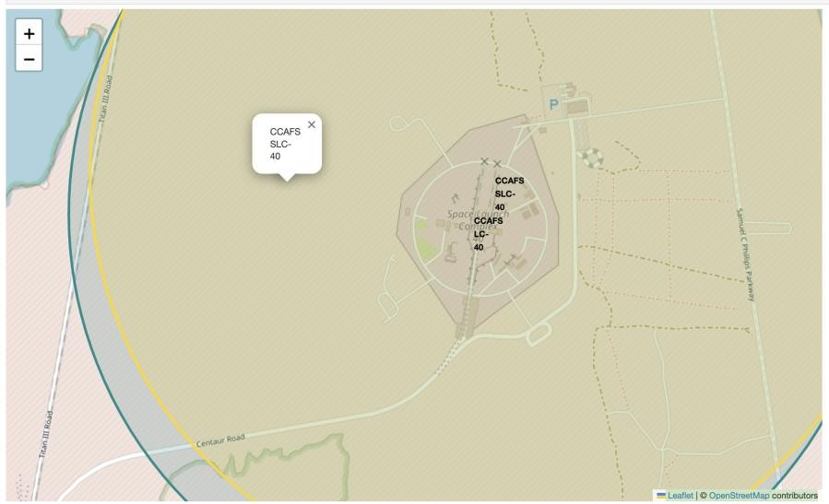
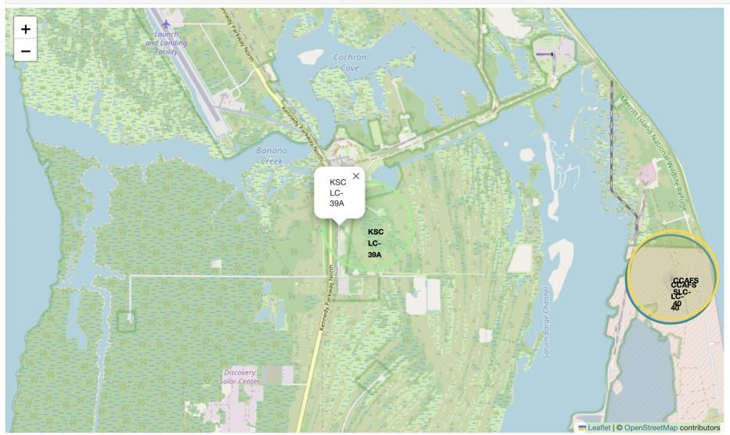
Folium Map - Launch Sites

Slide 29
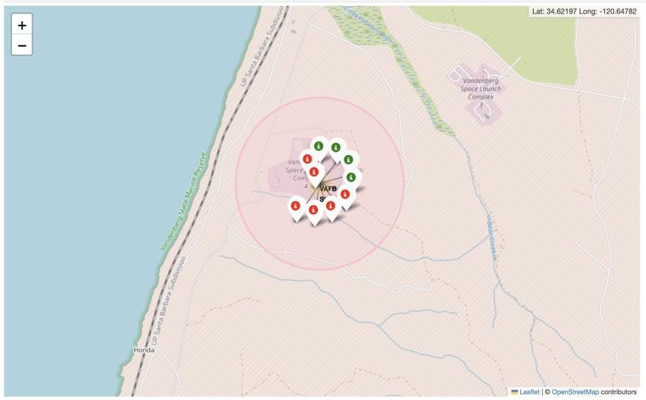
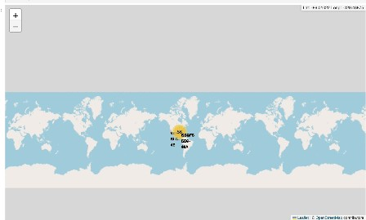
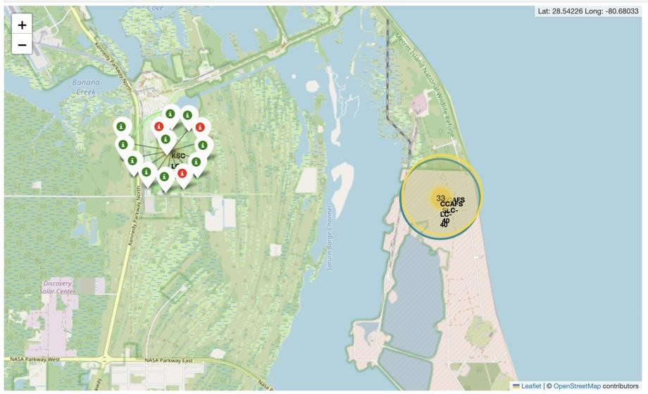
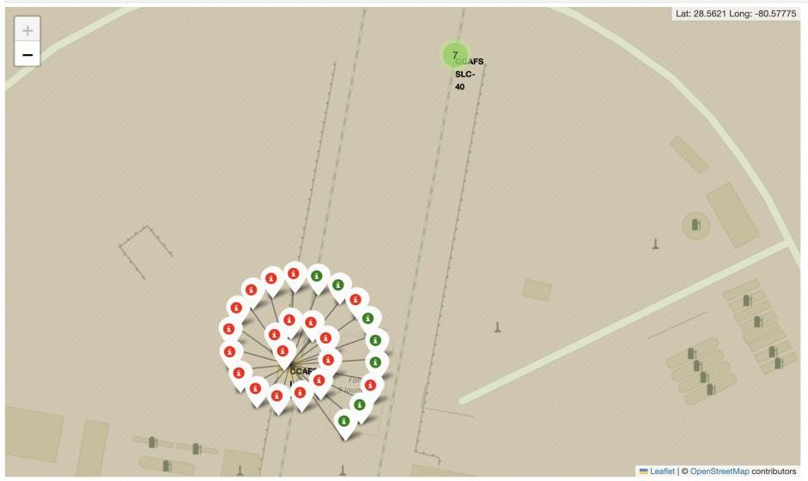
Folium Map – Launch Outcome
An interactive map displaying the total number of successful and failed launch outcomes.
Successful launches are green while failed launches are red

Slide 30

Section 4

Slide 31
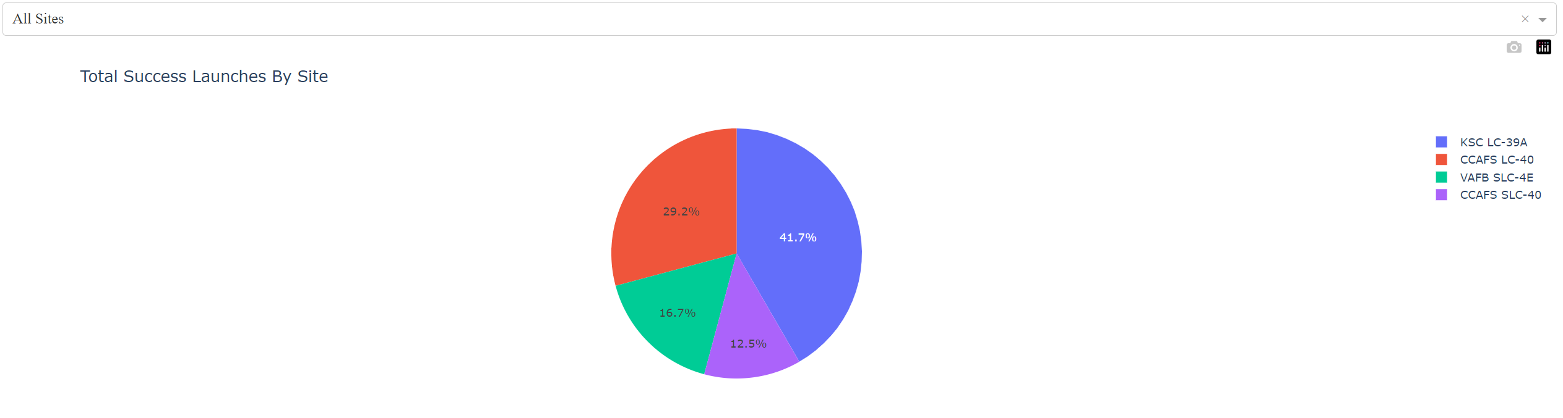
Dash – Launch Site Success Rates

Slide 32
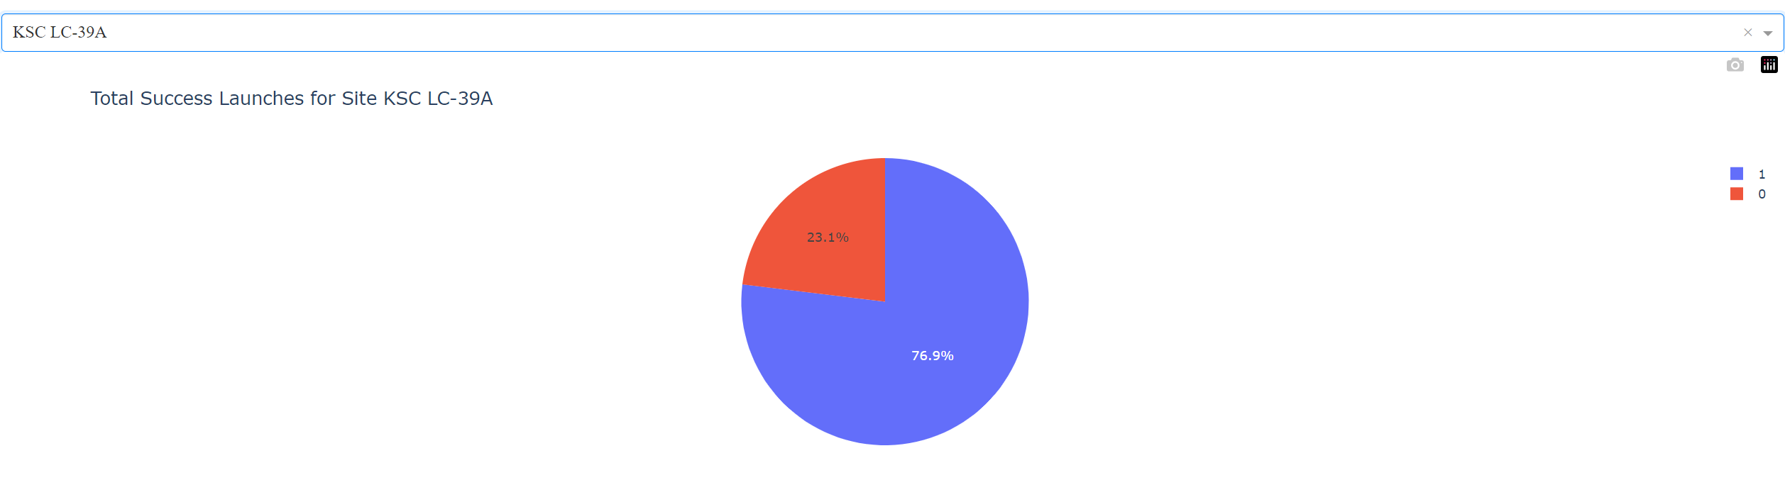
Dash – Highest Launch Site Success Rate

Slide 33
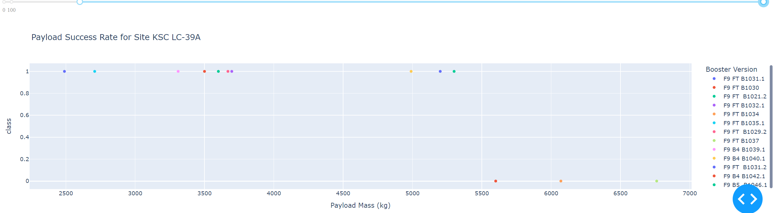
Dash – Payload Mass vs Success Rate Scatter Plot
A Scatter Plot that helps show the correlation between payload mass and success rate
Booster Version Category types are separated by color
The range slider above the graph allows you to customize the range of the x-axis
Most successful launches seem to be with a payload mass between 2000 to 6000 kg

Slide 34

Section 5

Slide 35
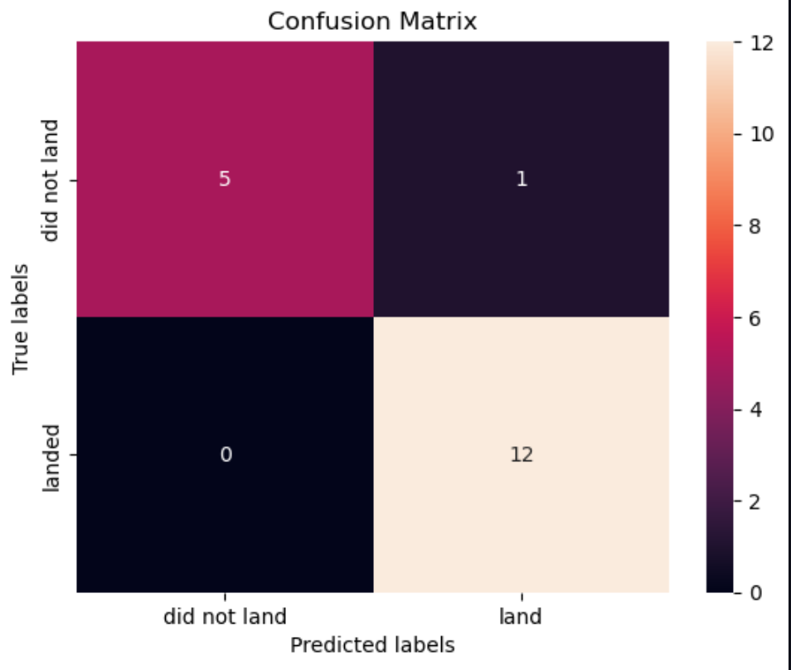

Confusion Matrix
A confusion matrix displays 4 different quadrants of information
Quadrant 1: False Positive
Incorrectly predicts rocket successfully landed
Quadrant 2: True Negative
Correctly predicts rocket failed to land
Quadrant 3: False Negative
Incorrectly predicts rocket failed to land
Quadrant 4: True Positive
Correctly predicts rocket successfully landed
Due to the small sample size, all ml algorithms have almost the same accuracy around 84 percent.

Slide 36
Conclusions
The machine learning algorithms have an F1 score of
0.89 which shows it's skill in accurately predicting both successful and
failed launches
Launches with a payload mass between 2000 and 6000 kg show the
highest rate of success
Launch Site KSC LC 39-A has the highest success rate among the
other launch sites
Orbits ES-L1, GEO, HEO, and SSO have a 100% success rate
Orbits ISS, GTO, and VLEO have the most launches
Launch Sites are located in close proximity to coastlines

Slide 37


